Slide 1
Summary Evaluation Platform
M.Sc. Final Project Report
Sergey Mordeev
Project Supervisor: Dr. Marina Litvak

Slide 2
Problem Statement - What
Gathering, processing and results’ interpretation are not simple in general
In a highly specialized field the “problem” becomes a “real headache”
Automatic Text Summarization Evaluation is no an exception…

Slide 3
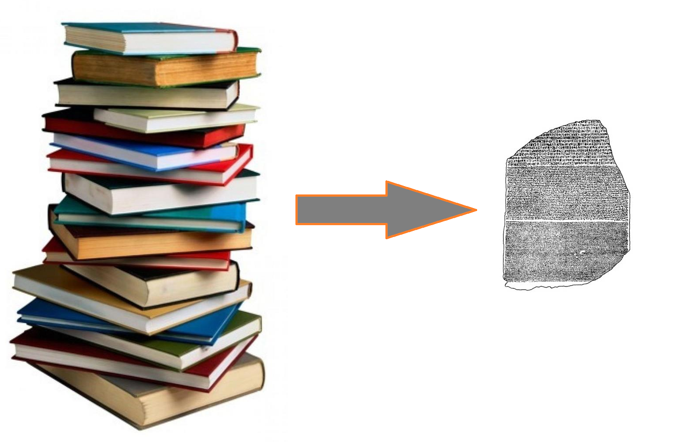
Summarization Task
In a “minimum” words: distilling the most important information from source(s) for particular user(s) and/or task(s)
Why? Over-information.
What by?
Humans [“the best one”?] (in reality, expensive and subjective)
Machines [automated] (in reality, ☺)

Slide 4
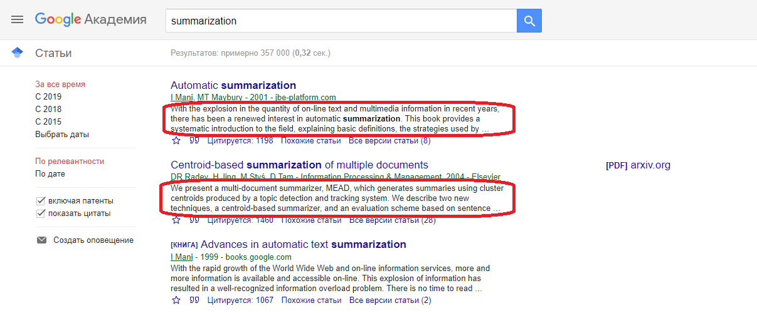
Summarization Task (in action) - Example

Slide 5
“Researcher” task
A “researcher” wants
Better than another “researcher” automatic summarizer
To prove or to have a direction for a prove that it is better
Not wasting a time on annoying intermediate steps
A “researcher” does not want
Manually perform repetitive tasks
Automate the process (it is not the main goal for her/him eventually)
Realize that s/he may advance faster
A “researcher” may also want
Integrate/Extend existing automation
[There is some partial support… latter on this]

Slide 6
The “Platform” Main Idea
Automate and help to a researcher to infer faster conclusions
More Concretely
Combine accepted evaluation metrics
Allow [some] analysis of metrics [visual/statistic]
Non-functional requirements:
Fast [faster than existing solutions]
Extensible [conceptually, further development should be possible]
Reusable [highly modular]
Self-contained [as less as possible dependencies]

Slide 7
Summary Evaluation (bird’s-eye view)
Metric Category | Concrete Implemented Metrics
Informativeness | Rouge Metrics Family AutoSummENG Metrics
Readability | Various Readability Metrics

Slide 8
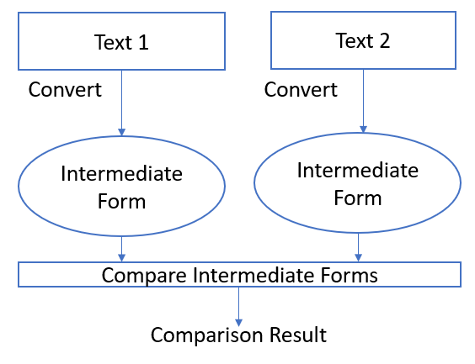
Text Comparisons

Slide 9

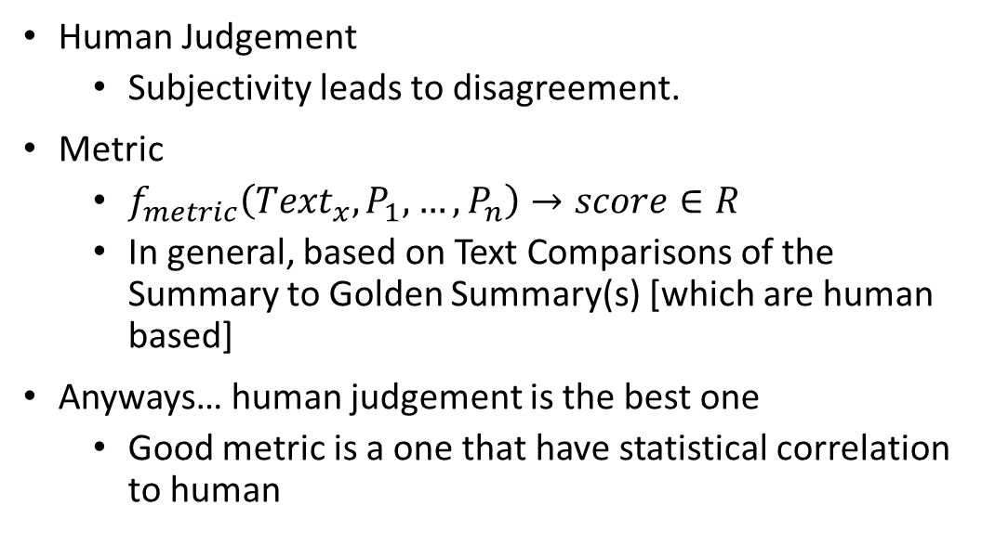
Summary Evaluation (“Informativeness”)
Human Judgement
Subjectivity leads to disagreement.
Metric
$f_{metric}\left({Text}_{x}, P_{1},…, P_{n}\right)→score∈R$
In general, based on Text Comparisons of the Summary to Golden Summary(s) [which are human based]
Anyways… human judgement is the best one
Good metric is a one that have statistical correlation to human

Slide 10
Summary Evaluation (“Surface”/“Readability”)
Readability Metrics are based on the on the mapping from the text itself to a real number
By themselves, do not tell a much about summary. However, within comparison to the original texts can show the summarizer behavior aspects.

Slide 11
Informativeness Implemented Metrics
Rouge Family (Perl “ported” code)
Rouge N
Rouge S(U)
Rouge L
Rouge W
AutoSummENG (Reuse of the original package)
Words
Characters

Slide 12

Surface (Readability) Implemented Metrics
Flesch Reading Ease (FRE)
$FRE=206.825−1.015\frac{\#(words)}{\#(sentence)}−84.6\frac{\#(syllables)}{\#(words)}$
The idea of this metric is that the long sentences and/or long words are hard to read.
Word Variation Index (OVIX)
$OVIX=\frac{log(\#words)}{log(2−{log(\#words)}/{log(\#unique_words)})}$
It is assumed that the metric could measure the idea of the text.
Proper Noun Ration (PNR)
$PNR=\frac{\#proper_nouns}{\#words}$
The reason for this measurement is that the number of proper nouns should increase the readability.

Slide 13
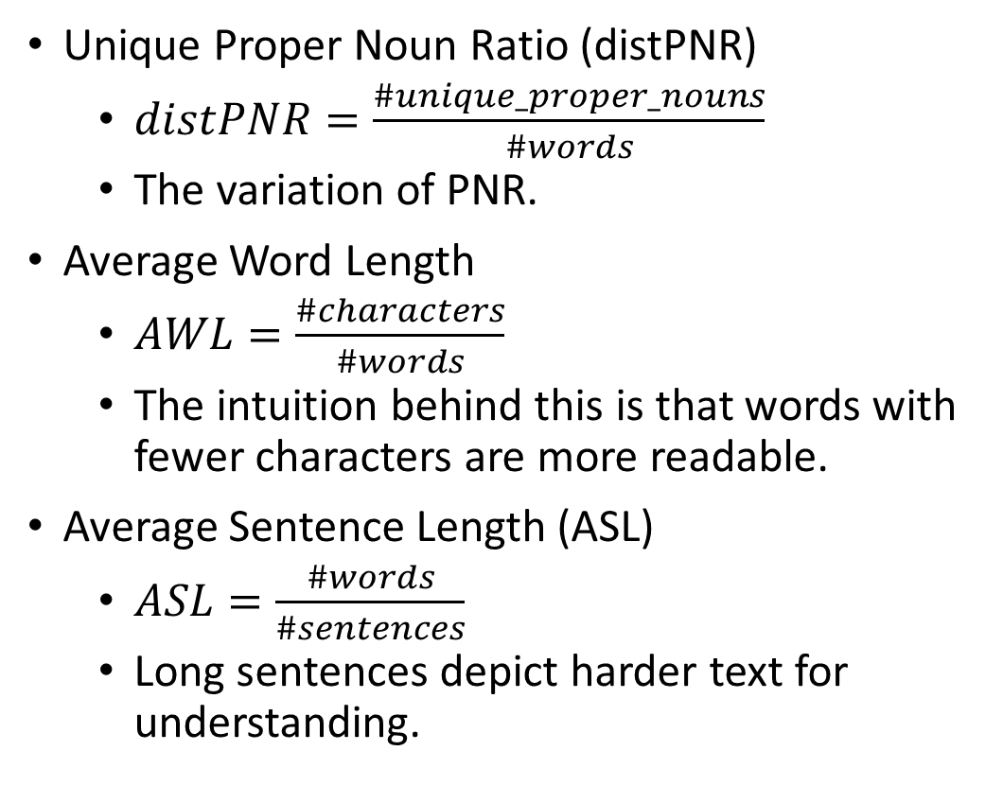
Surface (Readability) Implemented Metrics
Unique Proper Noun Ratio (distPNR)
$distPNR=\frac{\#unique_proper_nouns}{\#words}$
The variation of PNR.
Average Word Length
$AWL=\frac{\#characters}{\#words}$
The intuition behind this is that words with fewer characters are more readable.
Average Sentence Length (ASL)
$ASL=\frac{\#words}{\#sentences}$
Long sentences depict harder text for understanding.

Slide 14
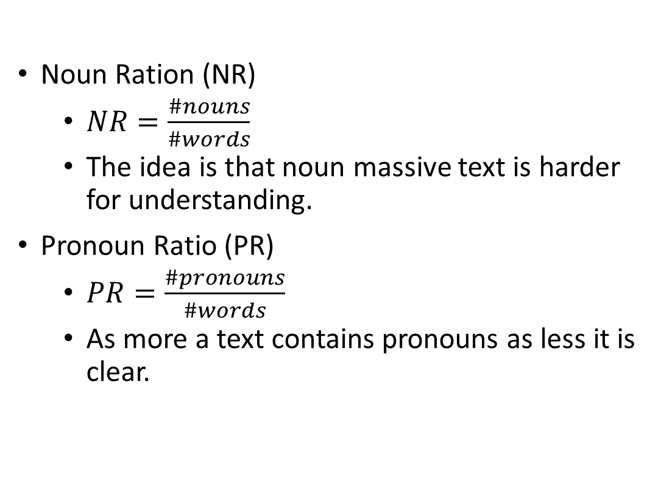
Surface (Readability) Implemented Metrics
Noun Ration (NR)
$NR=\frac{\#nouns}{\#words}$
The idea is that noun massive text is harder for understanding.
Pronoun Ratio (PR)
$PR=\frac{\#pronouns}{\#words}$
As more a text contains pronouns as less it is clear.

Slide 15
Surface (Readability) – “Better” Values
Metric | Is higher value better?
FRE | Yes
OVIX | Yes
PNR | Yes
distPNR | Yes
AWL | Opposite
ASL | Opposite
NR | Opposite
PR | Opposite

Slide 16
Statistical Analysis
Visual, descriptive and inferential statistics
Inferential: “Pretty” formatted Tukey HSD Letter Grouping
Requires calculation of common descriptive statistics (mean, std, p25, p50, p75)
Requires ANOVA calculations
HSD + algorithms for grouping
[The main idea is to say whether “my” summarizer behaves better or similar]
Visual Statistics: combining of multiple methods

Slide 17
Visual Statistics
Prove nothing being compared to inferential statistics
Human brain is the best machine for analyzing data
Implemented statistics
Various table representations
“3 in 1”:
Notched Box Plots
Jittered Scatter Plots
Tukey HSD Letter Grouping
“Heat Tables” for readability metrics (i.e. the readability “gain” while passing through the summarizer)

Slide 18
Implementation Forewords
“Pure” Java
3rd party dependency only by a (real) need
Multiple software engineering patterns in metrics calculation
IoC + DSL to define a pipeline
As a result, it is highly modular and configurable library code [“deep inside” CLI and GUI are just wrappers over the preconfigured container]
Adding new metrics is not a “big deal” as well as reuse it
The code is “kind of” highly parallel
All datatypes are immutable (cross thread boundaries)
Granularity level (i.e. “Processed Chunk”) is a document
Although it was an attempt to use Java’s ForkJoinPool… it became a headache because of its messy implementation.
Convention over configuration (in layout of packages)

Slide 19
Why DSL?
“The why behind” is to allow “externalization” for the metric calculations [a framework for further externalization]
OOP is highly “static” for this task
Just an opinion: Stanford Core NLP works in OOP way… Only Stanford Core NLP can extend it… Only Stanford Core NLP knows what is thread safe there… Only Stanford Core NLP knows how to add caching… “You want a banana you’ve got a jungle… with a monkey holding your banana”

Slide 20
DSL in Action
TextPipeline<String, List<String>> initialPipeline = new TextPipeline<>(new FileToStringProcessor()) .pipe(new TextToTokensProcessor()) .pipeIf(filters.contains(Constants.LOWER_CASE_FILTER), new LowerCaseFilterProcessor()) .pipeIf(filters.contains(Constants.PUNCTUATION_FILTER), new PunctuationFilterProcessor()) .pipeIf(filters.contains(Constants.STOP_WORDS_REMOVAL_FILTER), new StopwordsRemovalFilterProcessor()) .pipeIf(filters.contains(Constants.PORTER_STEMMER_FILTER), new PorterStemmerFilterProcessor()) .cacheIn(CacheMemoryTextProcessor::new) .extract(tokensExtractor);
initialPipeline.pipe(new NGramTextProcessor(rougeNParam)) .cacheIn(CacheMemoryTextProcessor::new) .extract(rougeNGramXExtractor);
initialPipeline.pipe(new SGramTextProcessor(useUnigrams, skipDistance)) .cacheIn(CacheMemoryTextProcessor::new) .extract(rougeSGramExtractor);

Slide 21
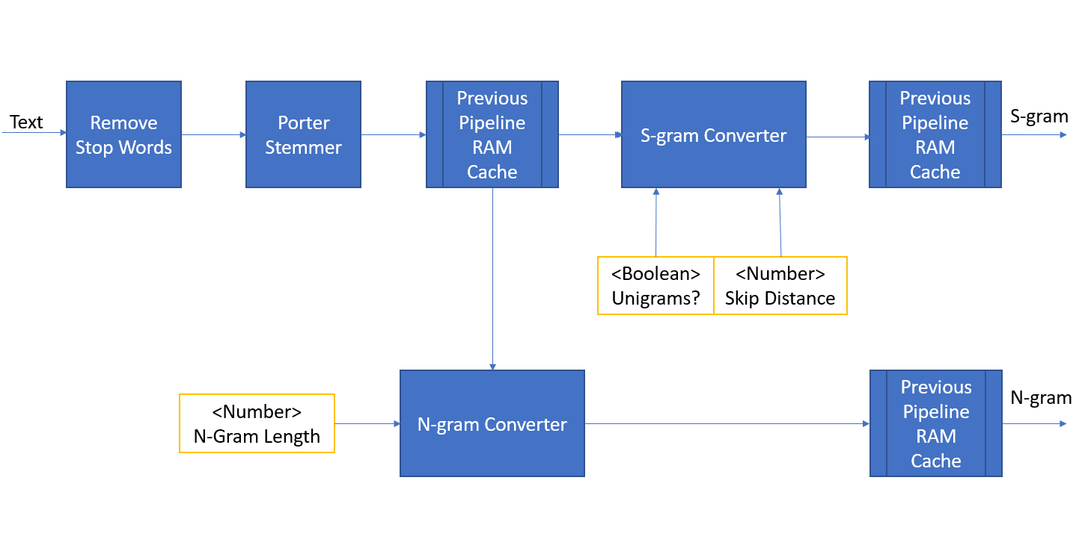
DSL in Action

Slide 22

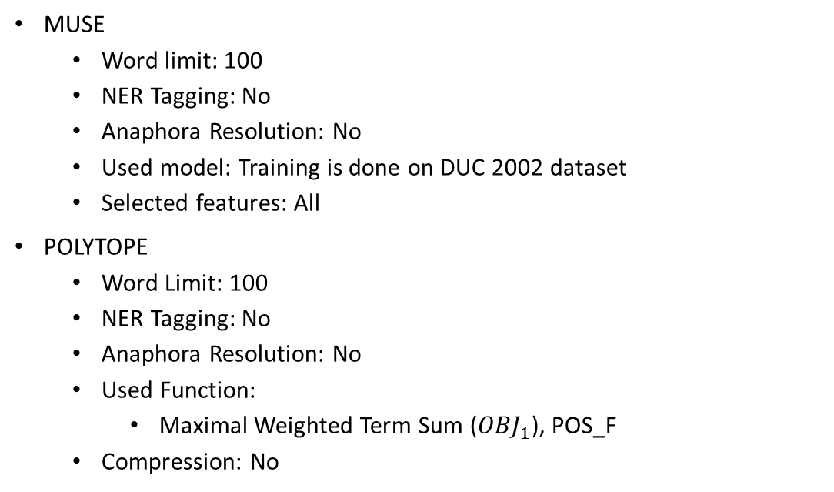
Experiments
MUSE
Word limit: 100
NER Tagging: No
Anaphora Resolution: No
Used model: Training is done on DUC 2002 dataset
Selected features: All
POLYTOPE
Word Limit: 100
NER Tagging: No
Anaphora Resolution: No
Used Function:
Maximal Weighted Term Sum (${OBJ}_{1}$), POS_F
Compression: No

Slide 23
Experiments
OCCAMS
Word Limit: 100
Weight of Terms: k = 200
Random Words:
Word Limit: 100

Slide 24
Configuration
Text Preprocessing
Punctuation marks removal
Stop words removal
Stemming (Porter)
ROUGE
ROUGE N: N grams of length 1, 2 and 3
ROUGE S: Skip distance of length 4 + Unigrams
ROUGE L
ROUGE W
Readability: All metrics described for both original documents and automatic summaries
AutoSummENG:
Words (Min: 1, Max: 4, Distance: 2)
Chars (Min: 1, Max: 4, Distance: 2)

Slide 25


Demo
Demo… Demo… Demo…

Slide 26

Conclusions - Benefits
Fast working solution for researchers in summarization field
Highly extensible library code (at least regarding metrics)
[We think] A goal achieved that researcher can have less effort for analyzing both a summary quality and summarizer tendencies (by readability)
Especially: combined plot of notched box + jittered scatter + HSD pretty tabulated grouping
Heat table for readability

Slide 27

Conclusions – Drawbacks / Further Development
Not a product in a broad sense
Modularity suffers (all in one codebase)
Pluggability suffers (additional metrics should be included on the fly)
Linkage between metric products and GUI is hardcoded
GUI components are “hardcoded” (should be DSLed)
Solution:
One declarative language both for pipeline => GUI generation => Statistical / Visualization plots

